Slide 1


QA Salesforce Project
QA Consulting
Alexander Walker

Slide 2

Qa Salesforce Project
Introduction
Demonstration
Conclusion
Q&A
Consultant journey

Slide 3


Introduction
Force Training Ltd
Public training courses
Creating a custom app
Profiles and users
Courses
Invoices
Declarative
Programmatic

Slide 4
Consultant Journey
Trailhead
SFBSX-101
DEX450
DEX403
SFCRT-403

Slide 5
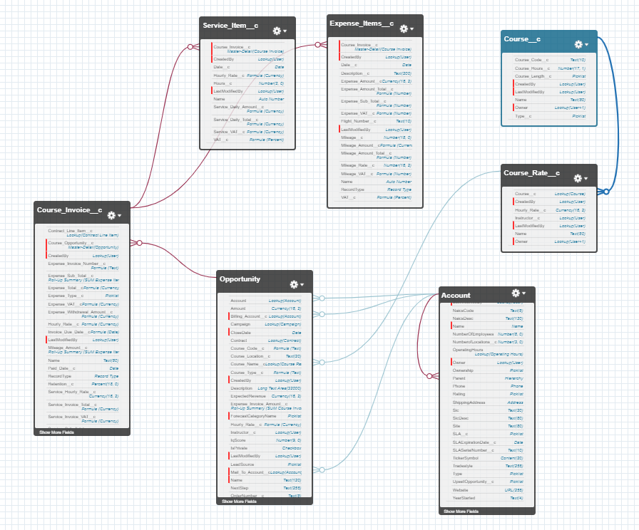

Slide 6

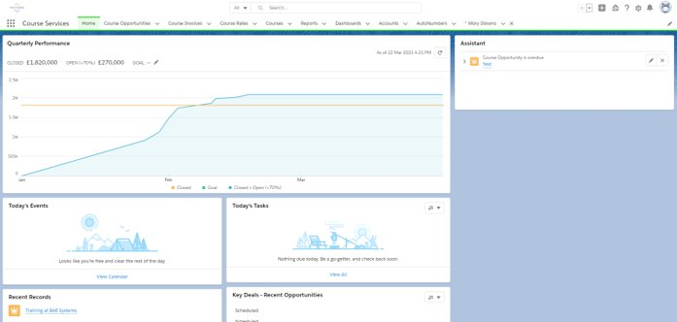
Demonstration

Slide 7
what was completed
Declarative:
Home page and apps
Users and Profiles
Course relevant objects
Security settings
Instructor
Billing Admin
Training Co-coordinator
Course Opportunities
Highlights pannel through lightning components
Related Lists
Service and Expense Invoices with Line Items
Privacy around VAT from Billing Admin
Validations rules for dates
Formulas for due dates
Different record types for invoices and line items
Notifications
Reports
Dashboards

Slide 8
what was completed
Programmatic:
Automatic invoice numbers
INV-{0001} and EXPINV-{0001}
Expense and Service PDF
Calandar events
Invoice created automatic when status changed
Email for courses and invoices
95% test coverage*

Slide 9
What was left behind or improved
Cloning
Testing for bulk
The pdf aesthetics could be improved
Auto naming for course and course rates
Better use of required fields
Using more custom object e.g. opportunity
Sandboxes and GitHub

Slide 10
Conclusion
QA Salesforce Project introduction and specification
Consultant Journey
Demonstration
Review
Great start to salesforce

Slide 11
Thank you for Listening

